Slide 1
PET dilemma
What’s wrong with our PET images?

Slide 2
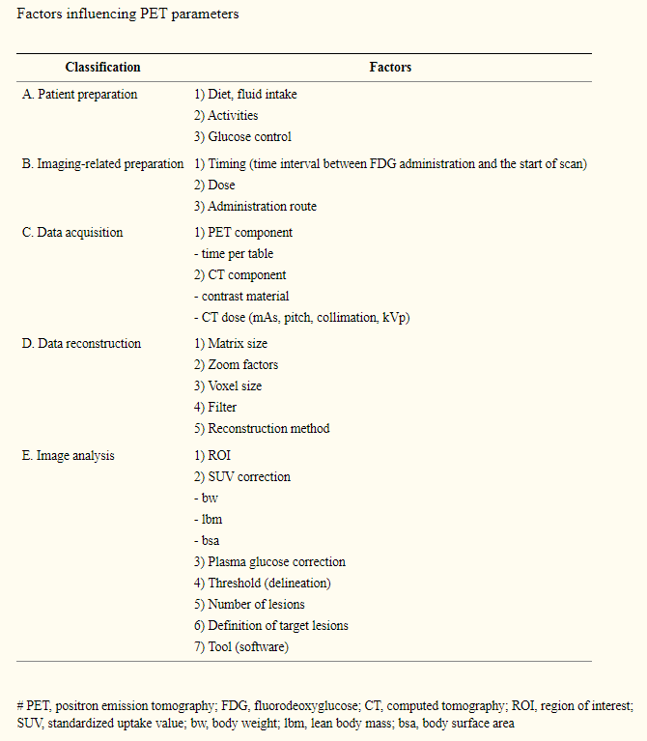
Factors influncing PET parameters

Slide 3

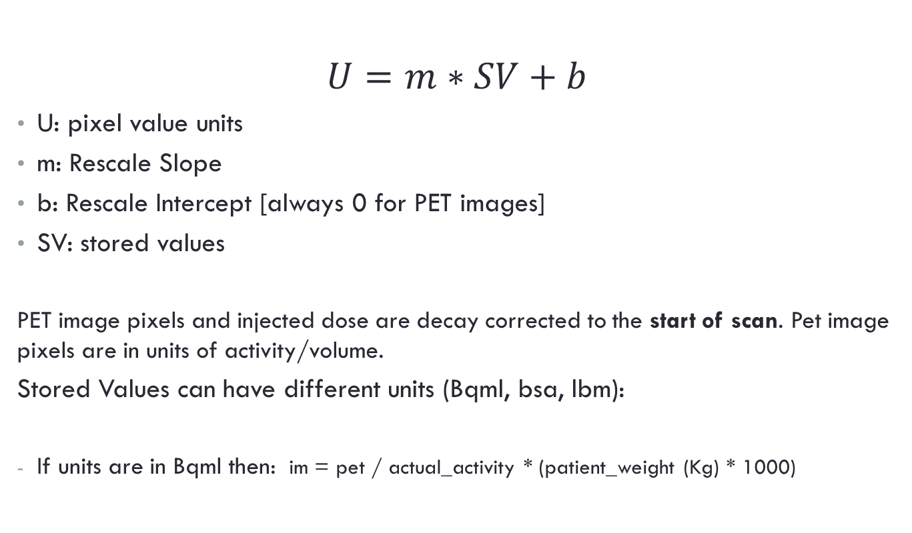
How is SUV calculated
$$U=m∗SV+b$$
U: pixel value units
m: Rescale Slope
b: Rescale Intercept [always 0 for PET images]
SV: stored values
PET image pixels and injected dose are decay corrected to the start of scan. Pet image pixels are in units of activity/volume.
Stored Values can have different units (Bqml, bsa, lbm):
If units are in Bqml then: im = pet / actual_activity * (patient_weight (Kg) * 1000)
Notes:
http://dicom.nema.org/medical/dicom/2014c/output/chtml/part03/sect_C.8.9.4.html

Slide 4
Info other calculations
If the original image units are Bq/ml and all the necessary data are present, PET images can be displayed in units of SUVs.
If the PET image units field, (54,1001) is set to BQML, then the PET images may be displayed in SUVs or in uptake in the form of Bq/ml. The application must do the conversion from activity concentration to SUV. GE Applications provide the following SUV types: SUV Body Weight (SUVbw), SUV Body Surface Area (SUVbsa), SUV Lean Body Mass (SUVlbm)
SUV References
Calculation of SUVbw and SUVbsa are according to the following equations, taken from Kim et al. Journal of Nuclear Medicine. Volume 35, No. 1, January 1994. pp 164-167.
SUVbw = (PET image Pixels) * (weight in grams) / (injected dose).
SUVbsa = (PET image Pixels) * (BSA in m2) * (10000 cm2/m2) / (injected dose).
(BSA in m2) = [(weight in kg)^0.425 * (height in cm)^0.725 * 0.007184].
Calculation of SUVlbm is according to Sugawara et al. Radiology, November 1999. pp 521-525.
SUVlbm = (PET image Pixels) * (LBM in kg) * (1000 g/kg) / (injected dose).
For Males: LBM in kg = 1.10 * (weight in kg) – 120 * [(weight in kg) / (height in cm)]^2.
For Females: LBM in kg = 1.07 * (weight in kg) – 148 * [(weight in kg) / (height in cm)]^2.
Images converted to SUVbw are displayed with units of g/ml
Images converted to SUVbsa are displayed with units of cm2/ml
Images converted to SUVlbm are displayed with units of g/ml
Images with initial units of uptake (Bq/ml), may be converted to SUVs and back to uptake or to another SUV type. However if the images are loaded in some units other than uptake, then no conversion shall be allowed. This holds true even if the units are the same as SUV units. This is because there is no way to know exactly how the SUVs were calculated.

Slide 5


Terminology
$$actual activity=total dose ∗decay$$
acquisition_datatime: date and time of the acquisition of the data
serie_datatime: Series Date (0008,0021) and Series Time (0008,0031) are used as the reference time for all PET Image Attributes that are temporally related, including activity measurements. Series Date (0008,0021) and Series Time (0008,0031) are not tied to any real-world event (e.g., acquisition start, radiopharmaceutical administration) and their real-world meaning are implementation dependent.
scan_datatime:
If serie_datatime<=aquisition_datatime → scan_datatime=serie_datatime
** Series Date/Time can be overwritten if the original PET images are post processed and a new series is generated. The software needs to check that the acquisition Date/Time (0008,0023) and (0008,0033) is equal to or later than the Series Date/Time. If it isn’t, the Series Date/Time has been overwritten and for GE PET images the software should use a GE private attribute (0009x, 100d) for the scan start datetime.
start_time:
start_datatime: scan_datatime.date + start time
decay_time: scan_datatime - start_datetime (seconds)
$$decay=2^{− \frac{decay_time}{half_life}}$$
Notes:
start_time_str = s.RadiopharmaceuticalInformationSequence[
0].RadiopharmaceuticalStartTime

Slide 6
SUV Computations from dicom fields
weight = patient weight = Study Patient Weight (10,1010)
height = patient height = Study Patient Size ( 10,1020)
sex = Study Patient Sex (0010, 0040)
tracer_activity = Total Dose (18,1074)
measured_time = Radio Pharmaceutical Start Time (18,1072)
half_life = Radio Nuclide Half Life(0018,1075)
scan_time = Series Date (0008,0021) + Series Time (0008,0031) **
** Series Date/Time can be overwritten if the original PET images are post processed and a new series is generated. The software needs to check that the acquisition Date/Time (0008,0023) and (0008,0033) is equal to or later than the Series Date/Time. If it isn’t, the Series Date/Time has been overwritten and for GE PET images the software should use a GE private attribute (0009x, 100d) for the scan start datetime.
actual activity = [tracer_activity * 2^( -(scan_time – measured_time) / half_life) ]

Slide 7
MATLAB implementation
% Get Scan time
scantime=dcm_hhmmss(dicomhd.AcquisitionTime);
% Start Time for the Radiopharmaceutical Injection
injection_time=dcm_hhmmss(dicomhd.RadiopharmaceuticalInformationSequence.Item_1.RadiopharmaceuticalStartTime);
% Calculate the decay
% decayFactor = e^(t1-t2/halflife);
decay=exp(-log(2)*(scantime-injection_time)/half_life);
%Calculate the dose decayed during procedure
injected_dose_decay=injected_dose*decay; % in Bq
% injected_dose_decay=injected_dose*dicomhd.DecayFactor; % in Bq
% Calculate SUV.
% SUV = (2DSlice x Calibration factor x Patient Weight) / Dose after decay
% SUV=slice*calibration_factor*ptweight/injected_dose_decay;
SUV=double(slice)*ptweight/injected_dose_decay; % NOTE that the "slice" coming in already has the calibration factor.

Slide 8
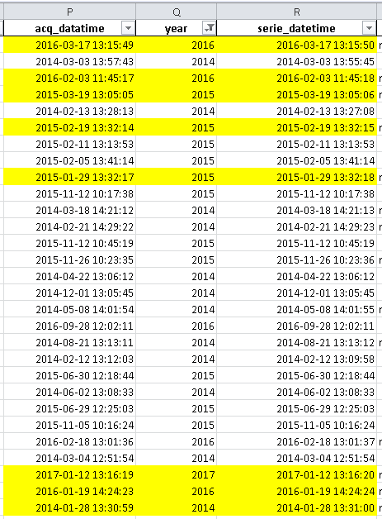
Patients 2014-2017
serie_datatime<=aquisition_datatime is not true!
1 second difference
decay_time estimated to be 1.75 * 3600
On 109 patients, 43 estimated decay times!

Slide 9
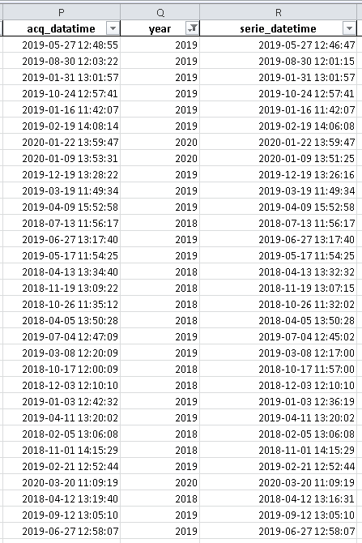
Patients 2018-2020
serie_datatime<=aquisition_datatime ALWAYS true!
On 101 patients, decay time never estimated!

Slide 10
PET EARL

